Slide 1

Ruby on Rails

Slide 2
About today…
Ruby on Rails
Building RESTful APIs

Slide 3
Allows communication between applications using HTTP methods

Slide 4
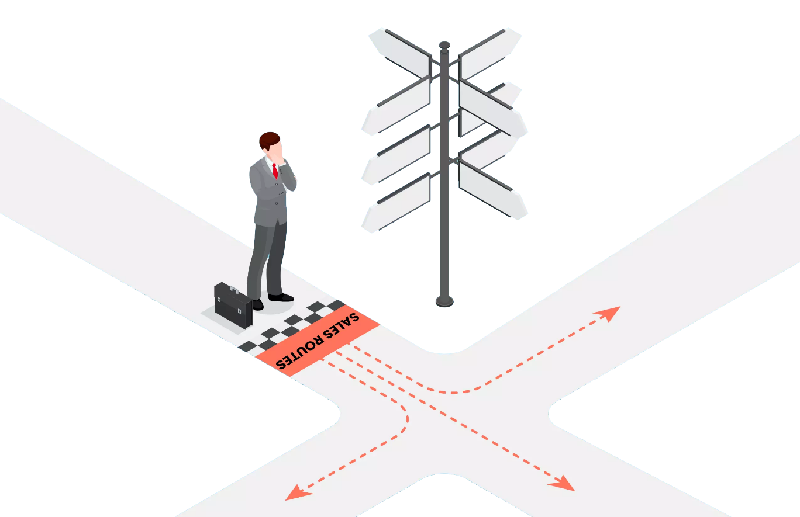
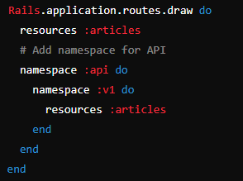
Configuring Routes
Update config/routes.rb
For handling API requests
Mention resource to provide

Slide 5
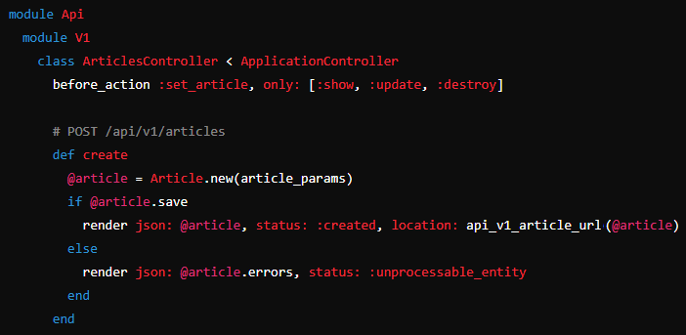
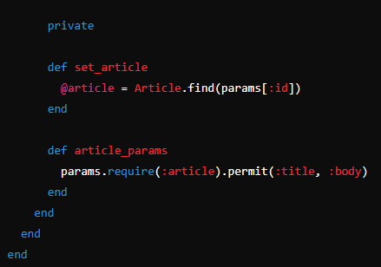
Implementing API-specific Controller
Create or update
app/controllers/api/v1/articles_controller.rb
Articles Controller

Slide 6
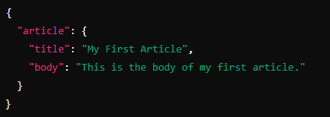
Testing the API with Postman
Create a POST Request.
URL: http://localhost:3000/api/v1/articles
Set Headers
Key
Content-Type
Value
application/json
Set Body
(raw, JSON)
Send Request

Slide 7


Slide 8

What is the purpose of adding API functionality to an existing Rails app?
To enhance the existing application's capabilities by enabling data access via API
Which file do you modify to define routes in a Rails application?
config/routes.rb
In which module and namespace would you typically define API controllers in Rails?
module: Api, namespace: V1
What HTTP status code is returned upon successfully creating a new article via the API?
201 Created

Slide 9

Task 1
Create an API to apply Fetching Data mechanism

